Slide 1
Workplace Mental Health Data Analysis
By Connor Crowley, Farhan Mohammad, Leor Seal, and Elena Tarassenko

Slide 2
Data Set
This dataset is from a 2014 survey that measures attitudes towards mental health and frequency of mental health disorders in the tech workplace.
Questions
What does the data look like and what needs to be cleaned?
What is the correlation between company size and access to benefits?
Is there a correlation between people who have a family history of mental illness and those seeking treatment?
Is there a correlation between people with mental health condition that interferes with their work and the size of the company/organization they have?
Does being employed in a tech company influence the attitude towards discussing mental health with coworkers?
Does being employed in a tech company influence the attitude towards discussing mental health with supervisors?
What are some general trends in the dataset by certain demographics?
Does remote work influence the access and/or awareness of mental health issues?

Slide 3
Question 1
Is there a correlation between people who have a family history of mental illness and those seeking treatment?
Hypothesis: There is a strong correlation between these two categories.

Slide 4
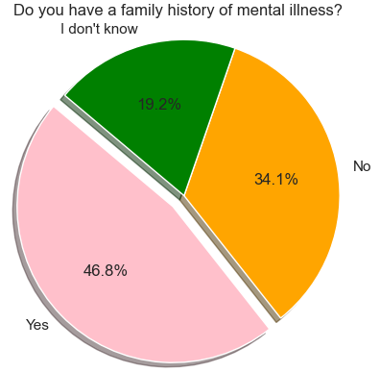
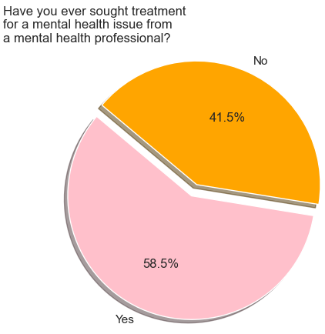
Visualizations

Slide 5
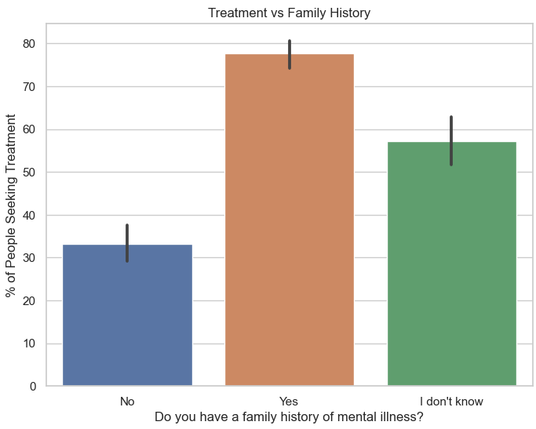
Cross Tabulated Analysis
Hypothesis Testing
Perform statistical test such as the Chi-Square test to determine if the observed associations are statistically significant or if they could have occurred by chance.
P-value > 0.05 therefore there is a strong correlation

Slide 6
Question 2
Is there a correlation between people with mental health condition that interferes or does not interfere with their work and the size of the company/organization they have?
Hypothesis: There is a correlation between people with mental health condition that interferes with their work and the size of the company/organization.

Slide 7
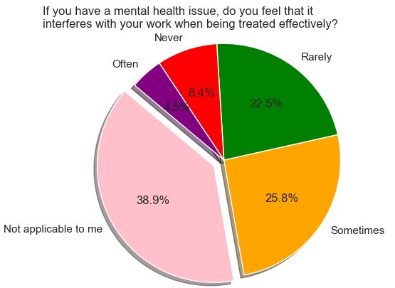
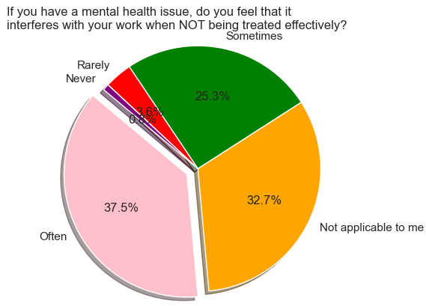
Visualization

Slide 8
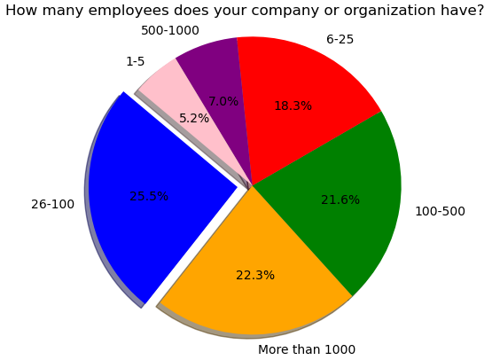

Slide 9
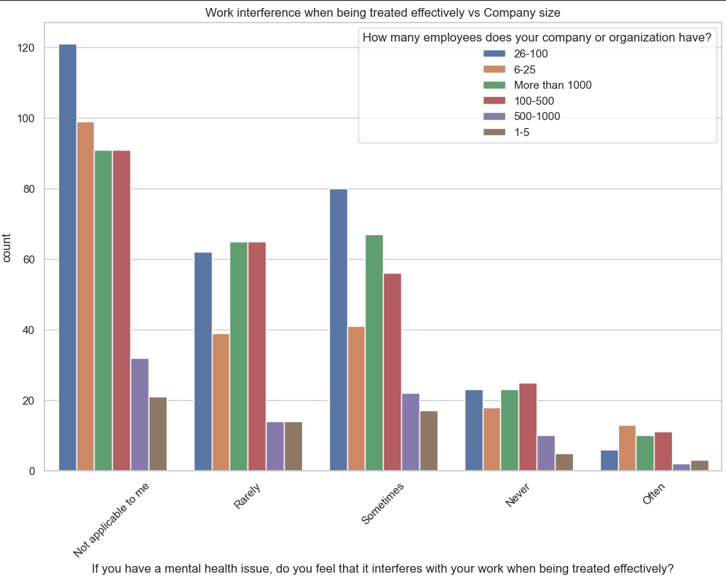

Slide 10
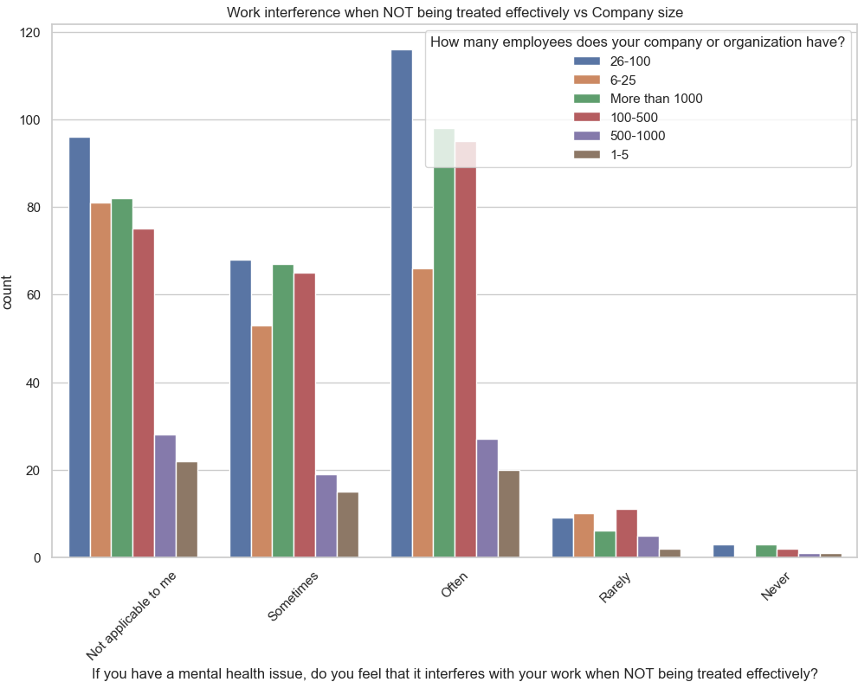

Slide 11
Conclusion: There is a correlation between these categories.

Slide 12
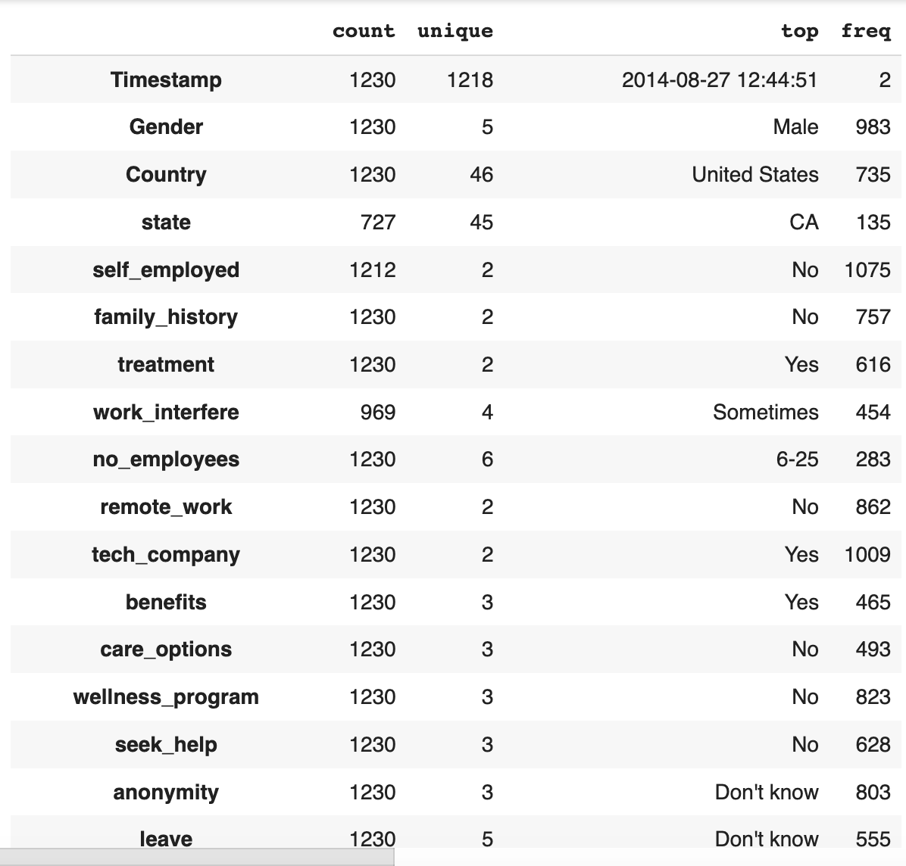
Target Profile of Survey Respondents:
Notes:
-The target Gender is Male, the target country is USA, state is CA, not self employed, no family history, yes to treatment, sometimes to work interference, number of employees 6-25, remote_work is No, most work for a tech company, the majority receive benefits and there are no care options, no wellness_program, do not seek help.

Slide 13
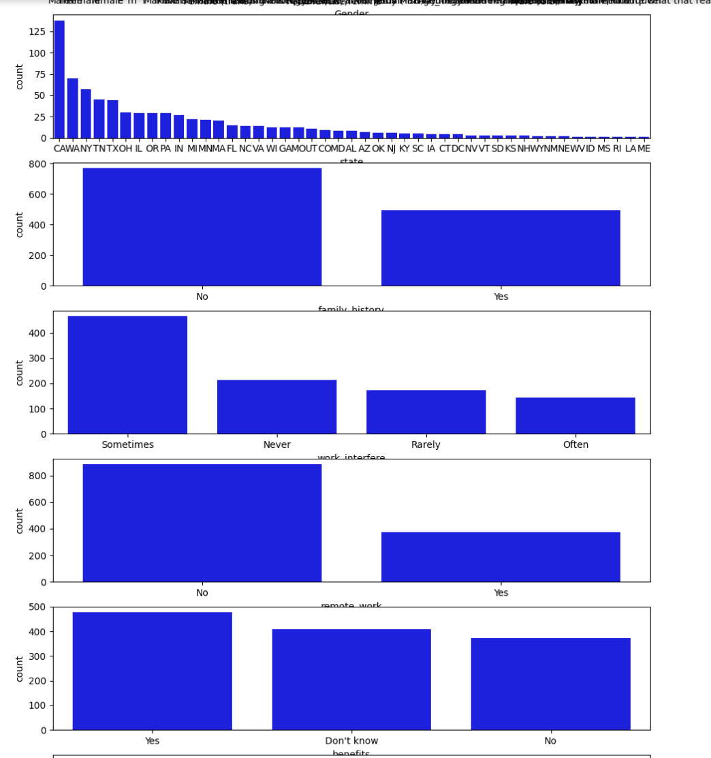
Demographics:
Notes:
-In terms of demographics, there were the most respondents from California (140 respondents), Washington (75 respondents), and New York (50 respondents).
-In terms of whether there was a history of mental illness, 8/13 respondents did not have a family history of illness, 5/13 had a family history of illness.
-The majority expressed that mental illness had at least some interference with work: 500 respondents said that the mental health illness definitely interfered with work, 200 expressed that it never interfered with work, 125 expressed that it rarely interfered with work, 100 expressed that it often interfered with work.
-The majority did not work remotely: 850 respondents did not work remotely, 400 respondents worked remotely.
-In terms of whether benefits were received: 500 respondents received benefits, 400 did not know if they received benefits, and 400 did not receive benefits.

Slide 14
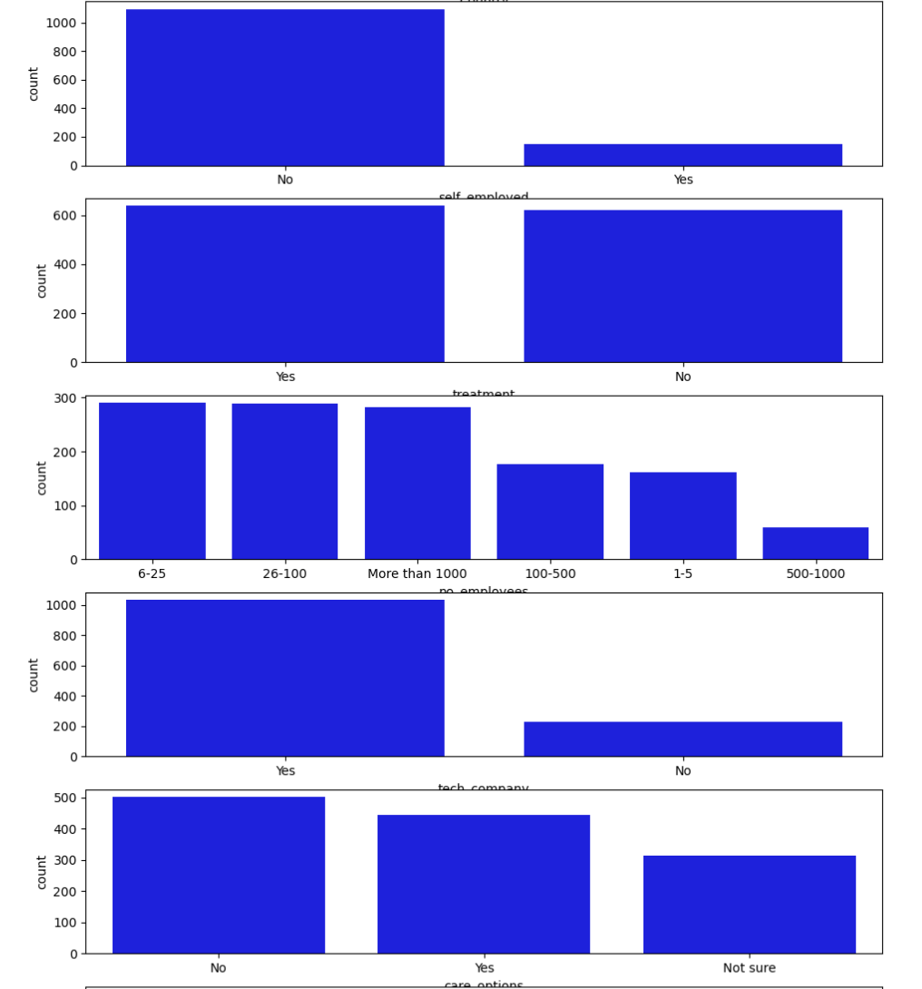
Demographics (cont.):
Notes:
-1000 employees were not self employed and worked in tech, 100 employees were self employed.
-Half were in treatment and half were not in treatment: 600 were in treatment, 600 were not in treatment.
-300 employees were in companies 6-25 individuals, 300 employees in companies 26-100 individuals, 300 with more than 1000 individuals, 150 with 100-500 individuals.
-1000 employees worked for the tech company, 200 did not work for the tech company.
-500 employees said there were care options, 450 expressed that there were not care options, 300 were unsure of whether there were care options.

Slide 15
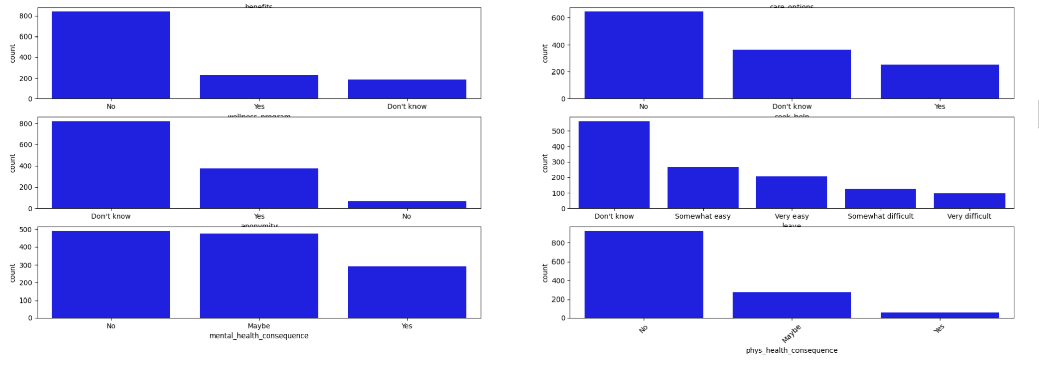
Demographics (cont.):
Notes:
-800 respondents were not in the wellness program, 200 respondents were in the wellness program.
-400 respondents were anonymous.
-480 respondents did not have mental_health_consequence, 480 respondents responded maybe to mental_health_consequence, 300 responded yes to mental_health_consequence.
-600 did not seek help, 300 did seek help.
-250 respondents expressed that it was somewhat easy for leave, 200 expressed that it was very easy for leave.
-900 respondents expressed that there was no phys_health_consequence, 200 respondents expressed that there may be phys_health_consequence.

Slide 16
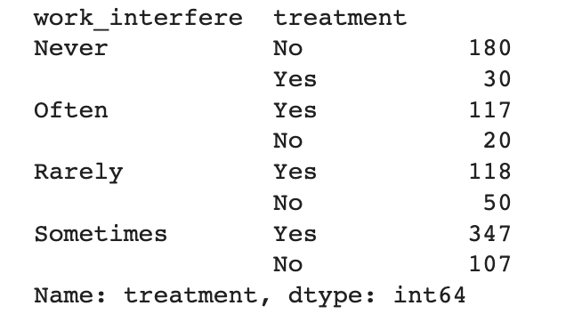
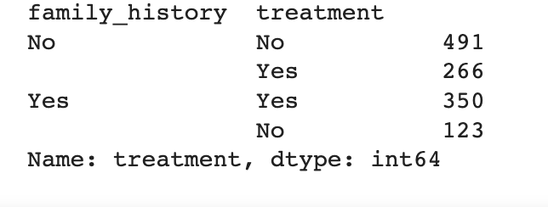
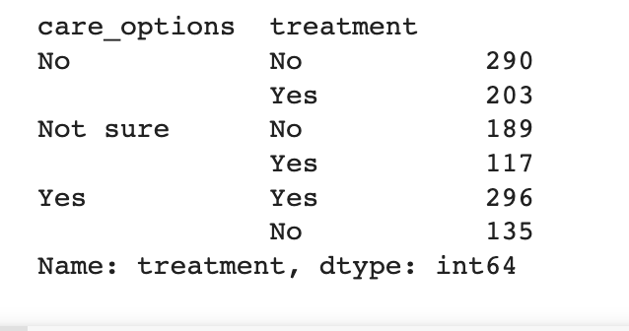
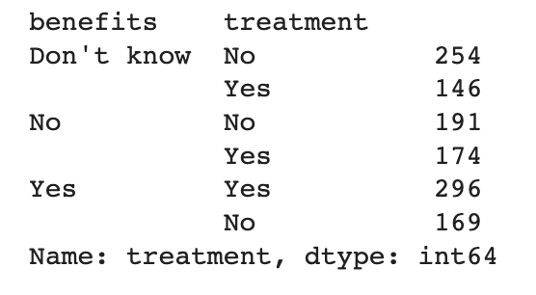
Factors Determining Treatment:
Notes:
-Those who had at least some interference with work were mostly in treatment.
-Those who had a family history of illness were mostly in treatment.
-Those who had care options were mostly in treatment, whereas those who did not have care options were mostly not in treatment.
-If they had benefits, they were mostly in treatment.

Slide 17
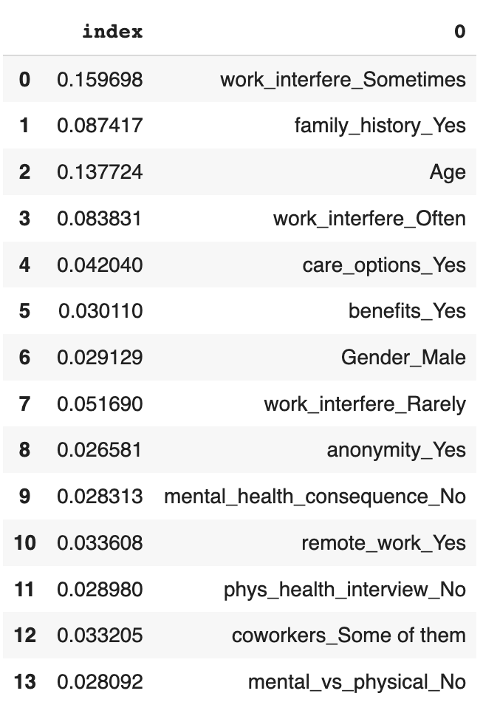
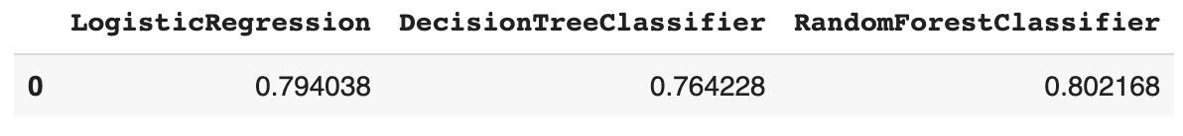
Modeling Results:
Ran a Logistic Regression, DecisionTreeClassifier and RandomForestClassifier on the dependent variable Treatment.
The conclusion was that treatment was sought in cases where there was sometimes or often recorded interference with work, there was a family history of mental illness, age was a significant factor, benefits were being received was also an indicator that treatment was being sought, male variable proved to be significant, anonymity, and mental health consequence, among other variables.
0
Notes:
X=df.drop(columns="treatment_Yes",axis=1)
y=df["treatment_Yes"]
X_train,X_test,y_train,y_test=train_test_split(X,y,test_size=0.30, random_state=0)
lgr=LogisticRegression()
lgr.fit(X_train,y_train)
lgr.score(X_test,y_test)
predictions=lgr.predict(X_test)
predictions
dt=DecisionTreeClassifier()
dt.fit(X_train,y_train)
dt.score(X_test,y_test)
rf=RandomForestClassifier()
rf.fit(X_train,y_train)
rf.score(X_test,y_test)
rf.feature_importances_
df1=pd.DataFrame(X.columns,rf.feature_importances_)
df1.iloc[0:50,:]
df1=df1.reset_index()
df2=df1.sort_values(by="index",ascending=False)
df2.to_csv("df3.csv")

Slide 18
Questions and Null Hypotheses:
Question One: Does being employed in a tech company influence the attitude towards discussing mental health with coworkers?
Null Hypothesis: Being employed in a tech company does not influence the attitude towards discussing mental health with coworkers.
Question Two: Does being employed in a tech company influence the attitude towards discussing mental health with supervisors?
Null Hypothesis: Being employed in a tech company does not influence the attitude towards discussing mental health with supervisors.

Slide 19
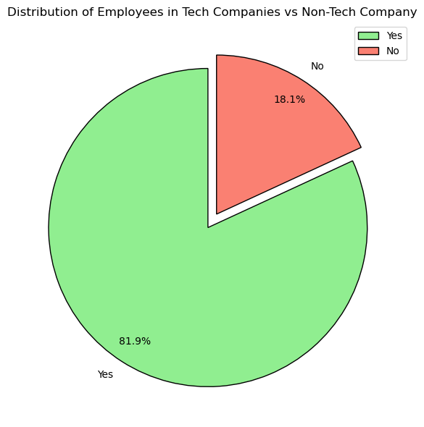
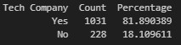
Tech Company Data

Slide 20
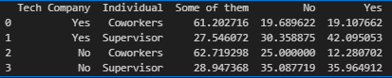
Statistical Analysis

Slide 21
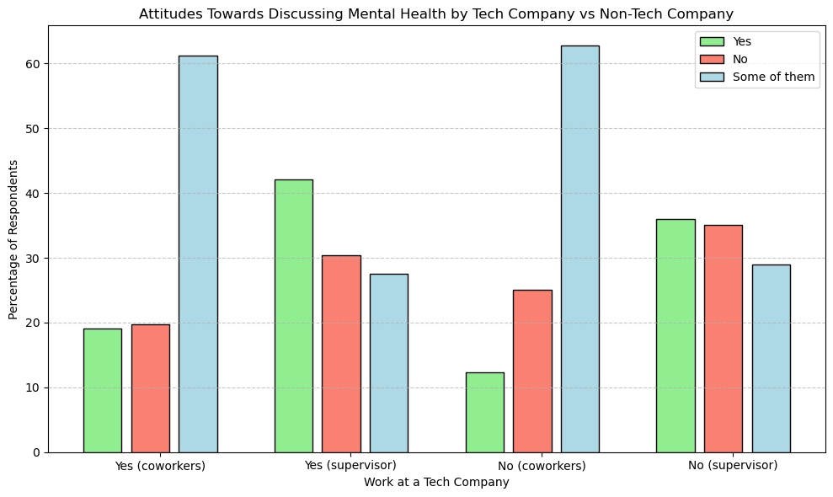
Grouped Bar Chart

Slide 22
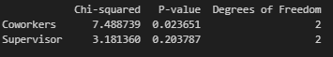
Chi-Squared Analysis

Slide 23
Question One Summary
Does being employed in a tech company influence the attitude towards discussing mental health with coworkers?
p-value = 0.02365
p-value < .05, therefore we can reject the null hypothesis
This implies that there may be a statistically significant relationship between being employed in a tech company and attitudes towards discussing mental health with coworkers.

Slide 24
Question Two Summary
Does being employed in a tech company influence the attitude towards discussing mental health with supervisor?
p-value = 0.203786976338983
p-value > .05, therefore we do not have enough evidence to reject the null hypothesis.
This implies that there may not be a statistically significant relationship between being employed in a tech company and attitudes towards discussing mental health with supervisors.

Slide 25
Question One Summary
What are some general trends in the dataset by certain demographics?
Gender
Geography
Age

Slide 26
Analytical Findings by Gender
There were three main trends by gender in the data:
Females showed a higher rate of both seeking treatment and family history of mental illness
Females showed a higher awareness of resources like company benefits and care options
Males showed a higher willingness to discuss a mental health issue with a supervisor

Slide 27
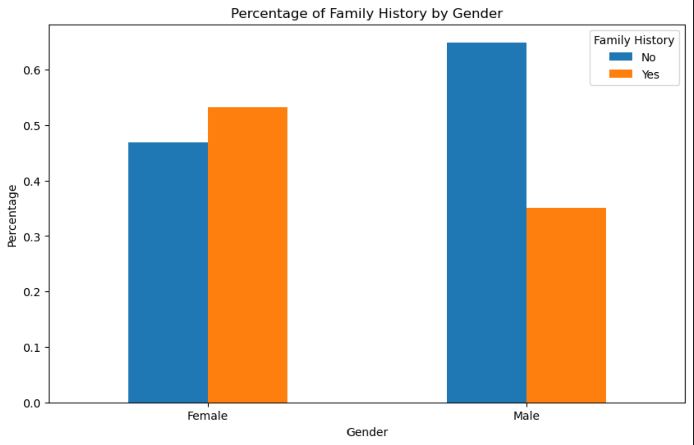
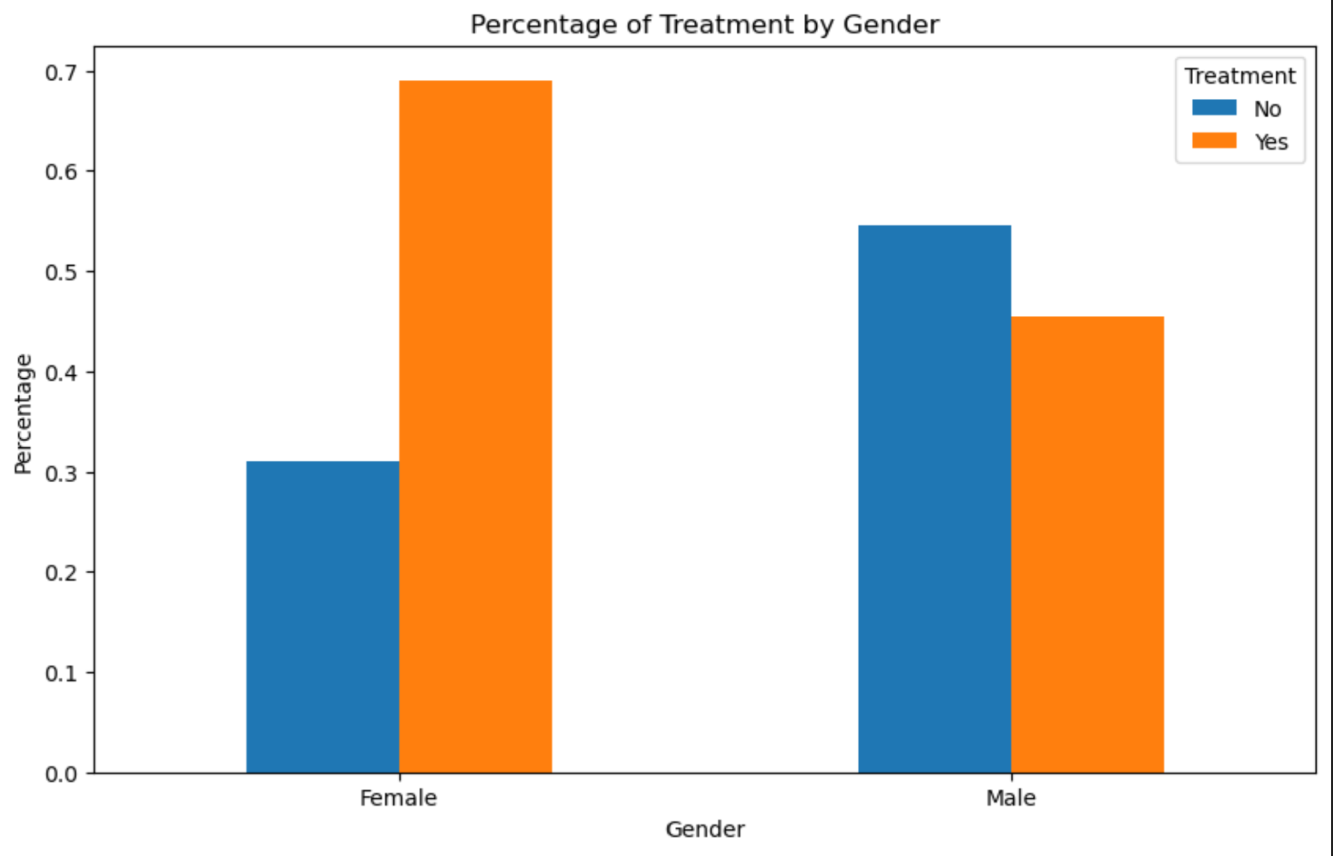
Data Visualizations

Slide 28
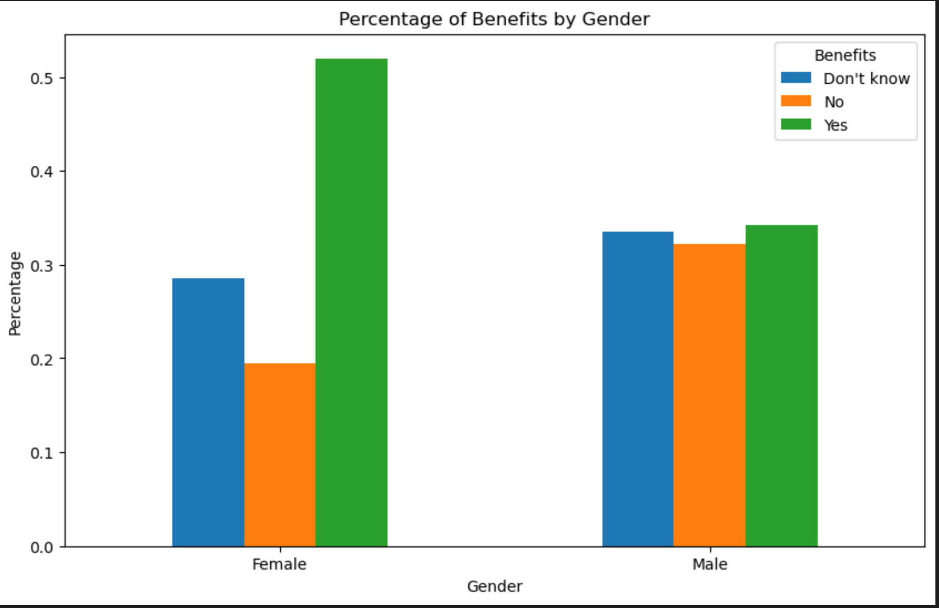
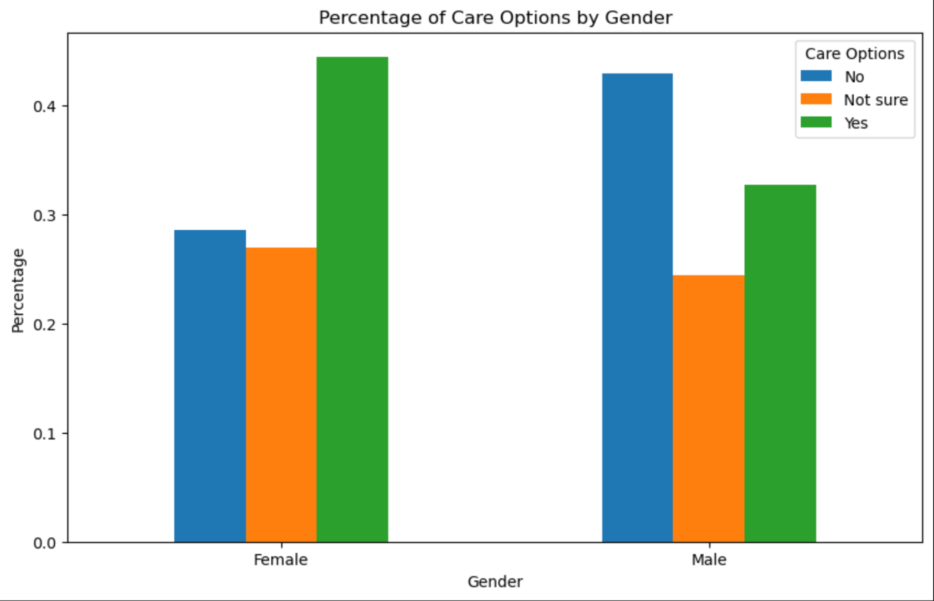
Data Visualizations

Slide 29
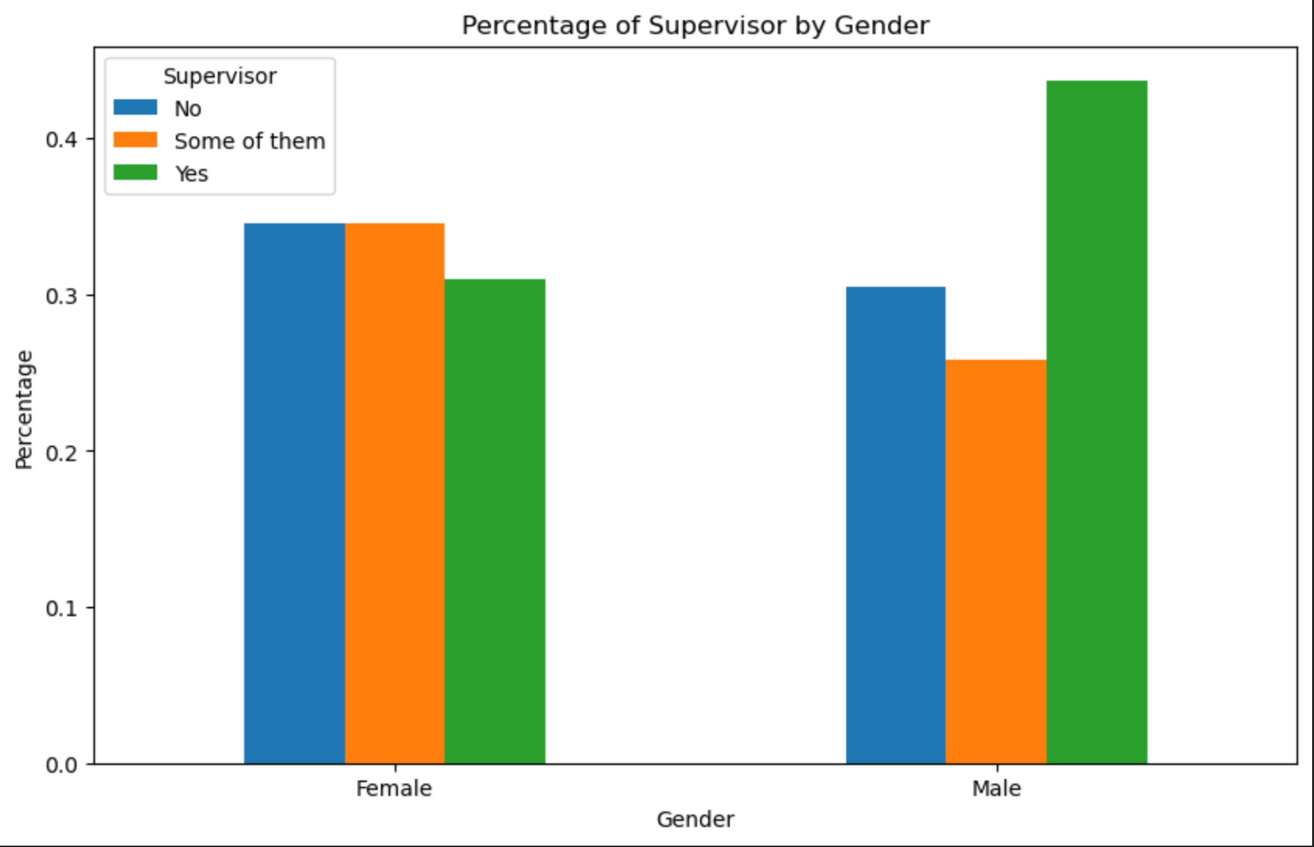
Data Visualizations

Slide 30
Analytical Findings by Geography
There were two main trends by geography in the data:
1. There is a higher rate of mental health treatment and family history in the USA.
2. There is higher awareness and availability of mental health resources in the USA.

Slide 31
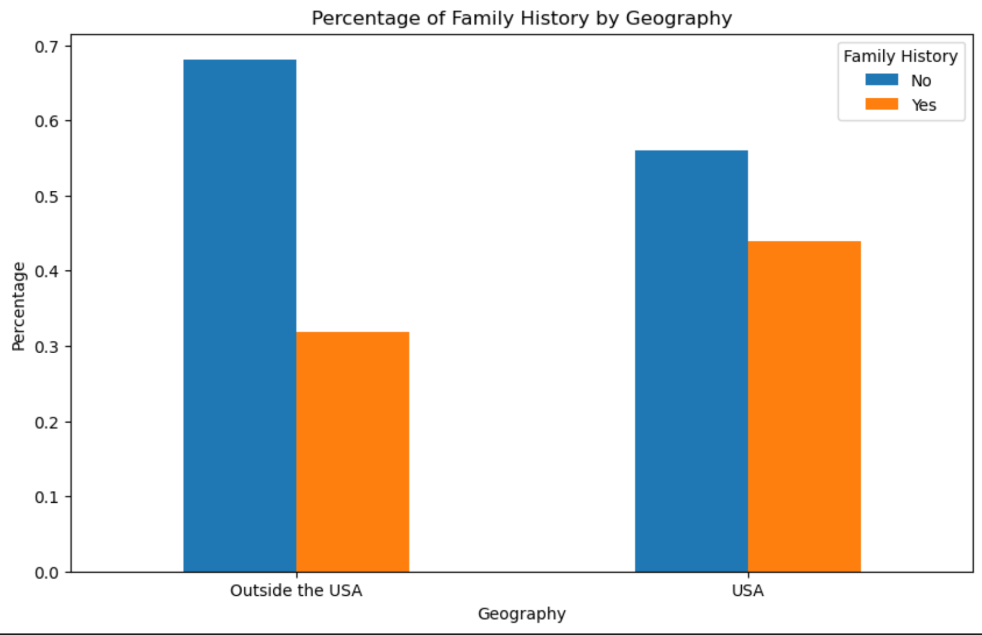
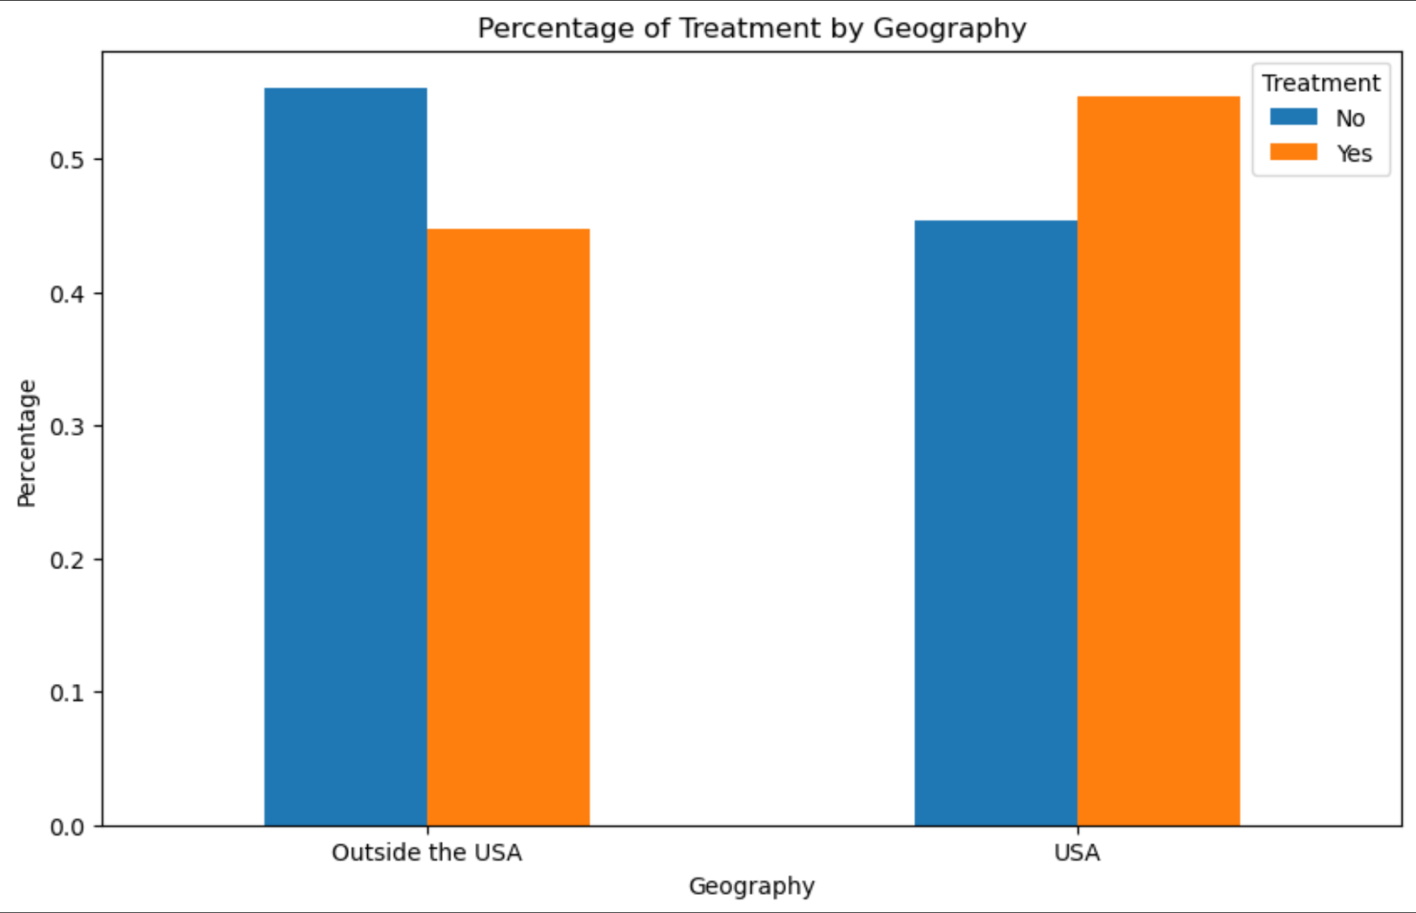
Data Visualizations

Slide 32
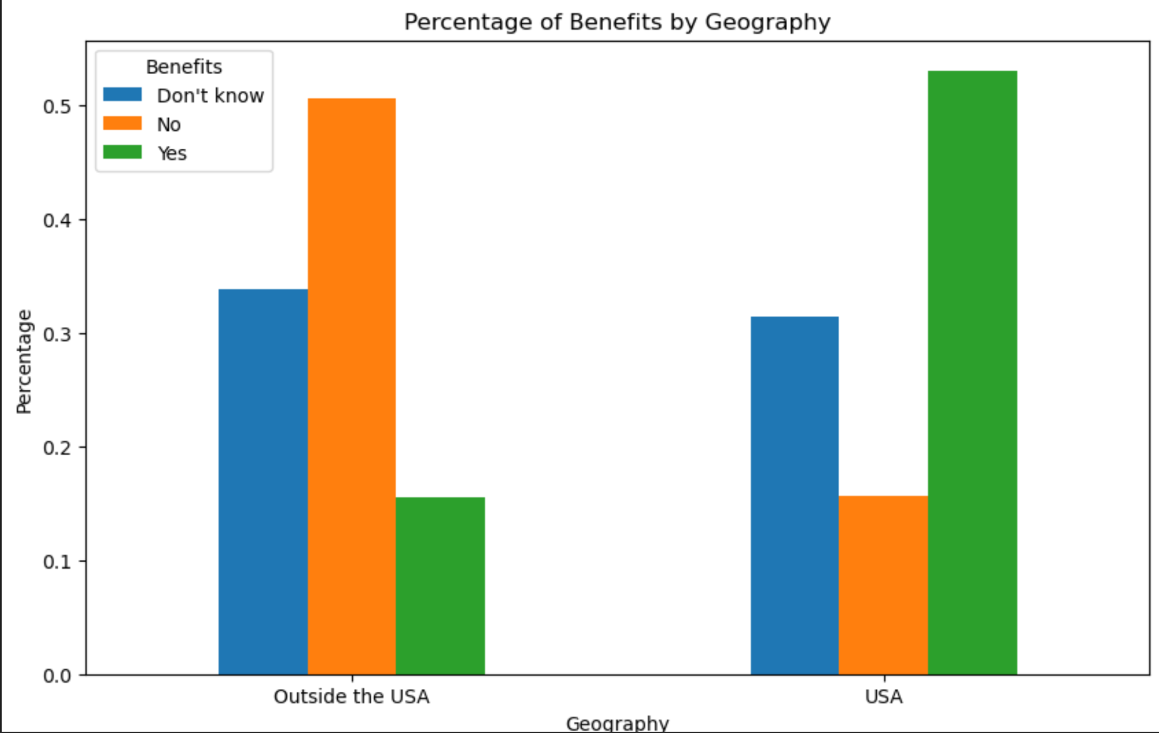
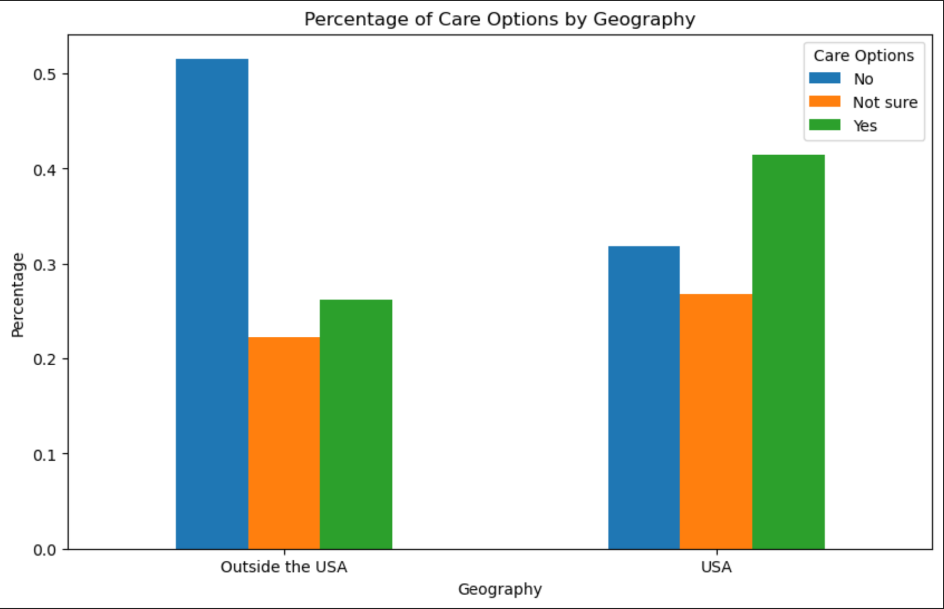
Data Visualizations

Slide 33
Analytical Findings by Age
There were three main trends by age in the data:
1. Self-employment levels went up with age
2. The rate of remote work went up with age
3. Awareness of benefits, care options, and wellness programs all went up with age

Slide 34
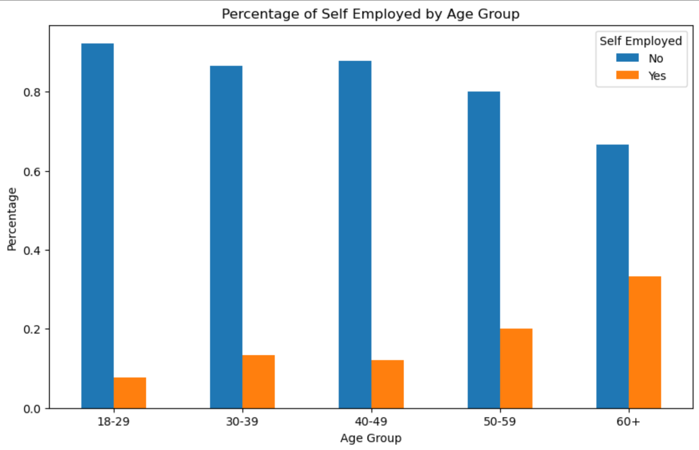
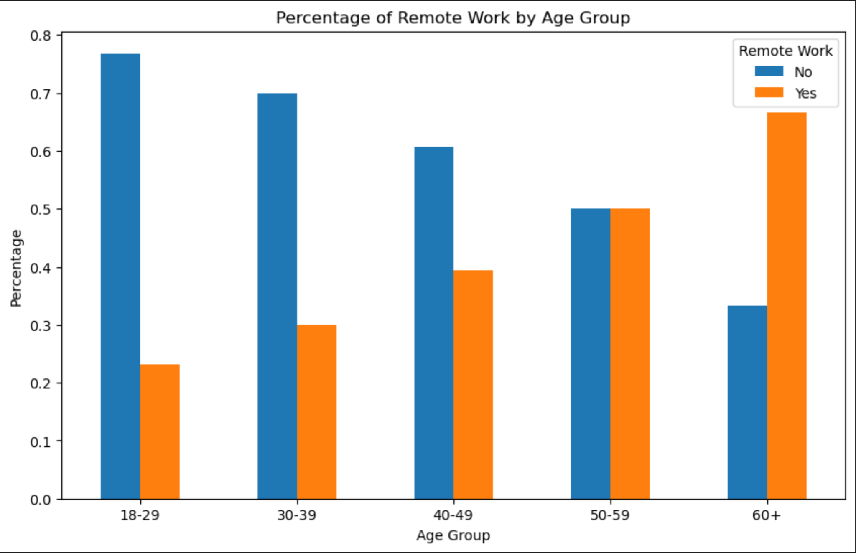
Data Visualizations

Slide 35
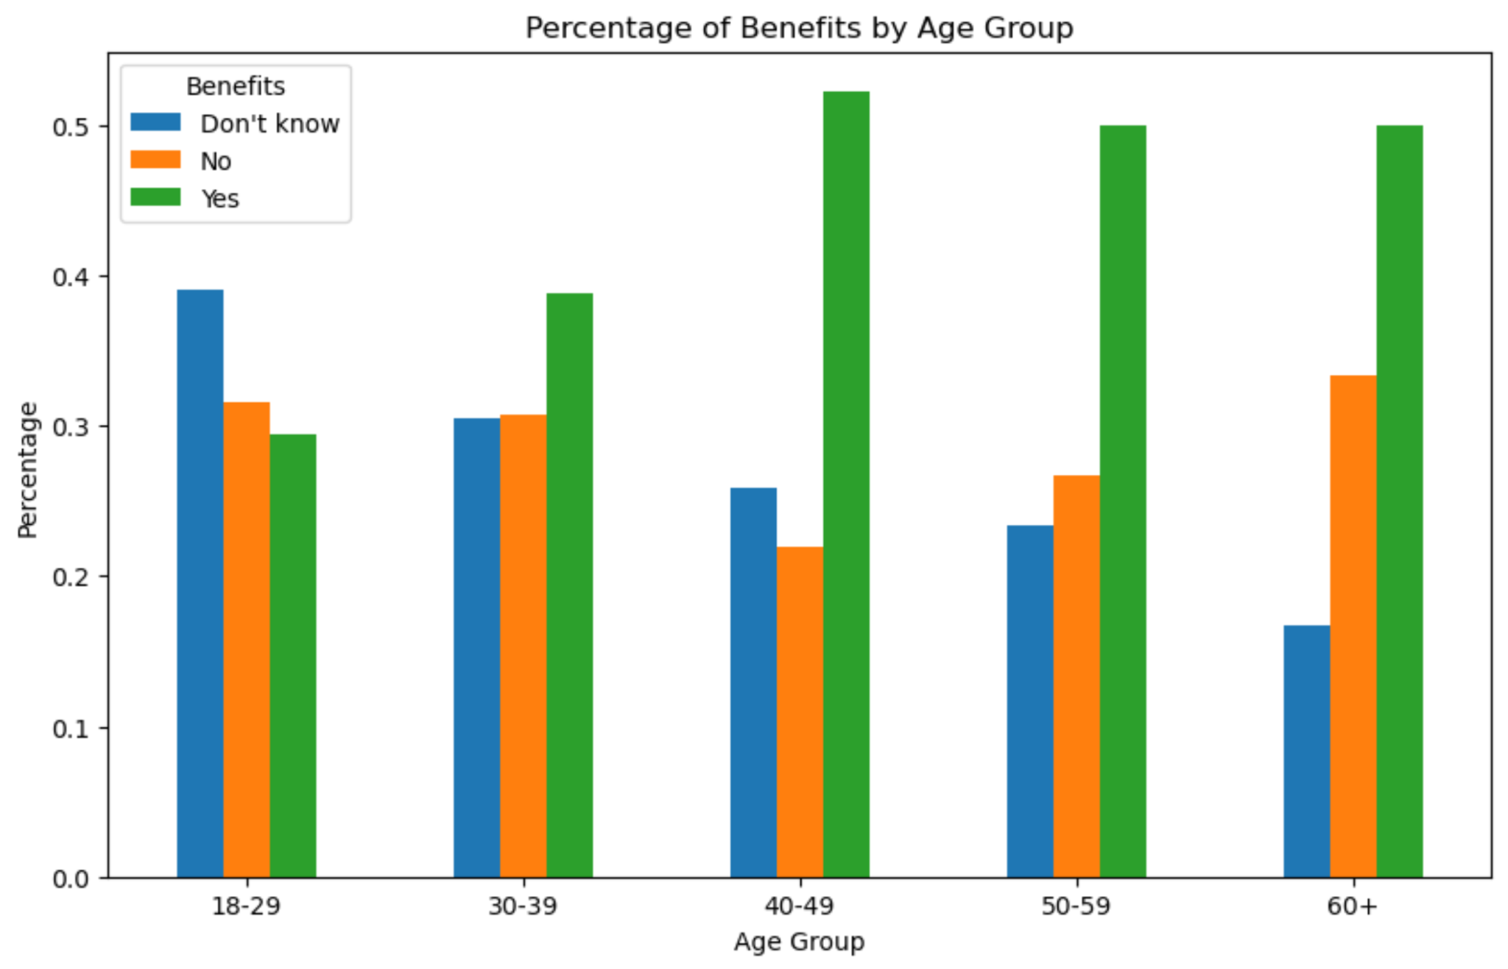
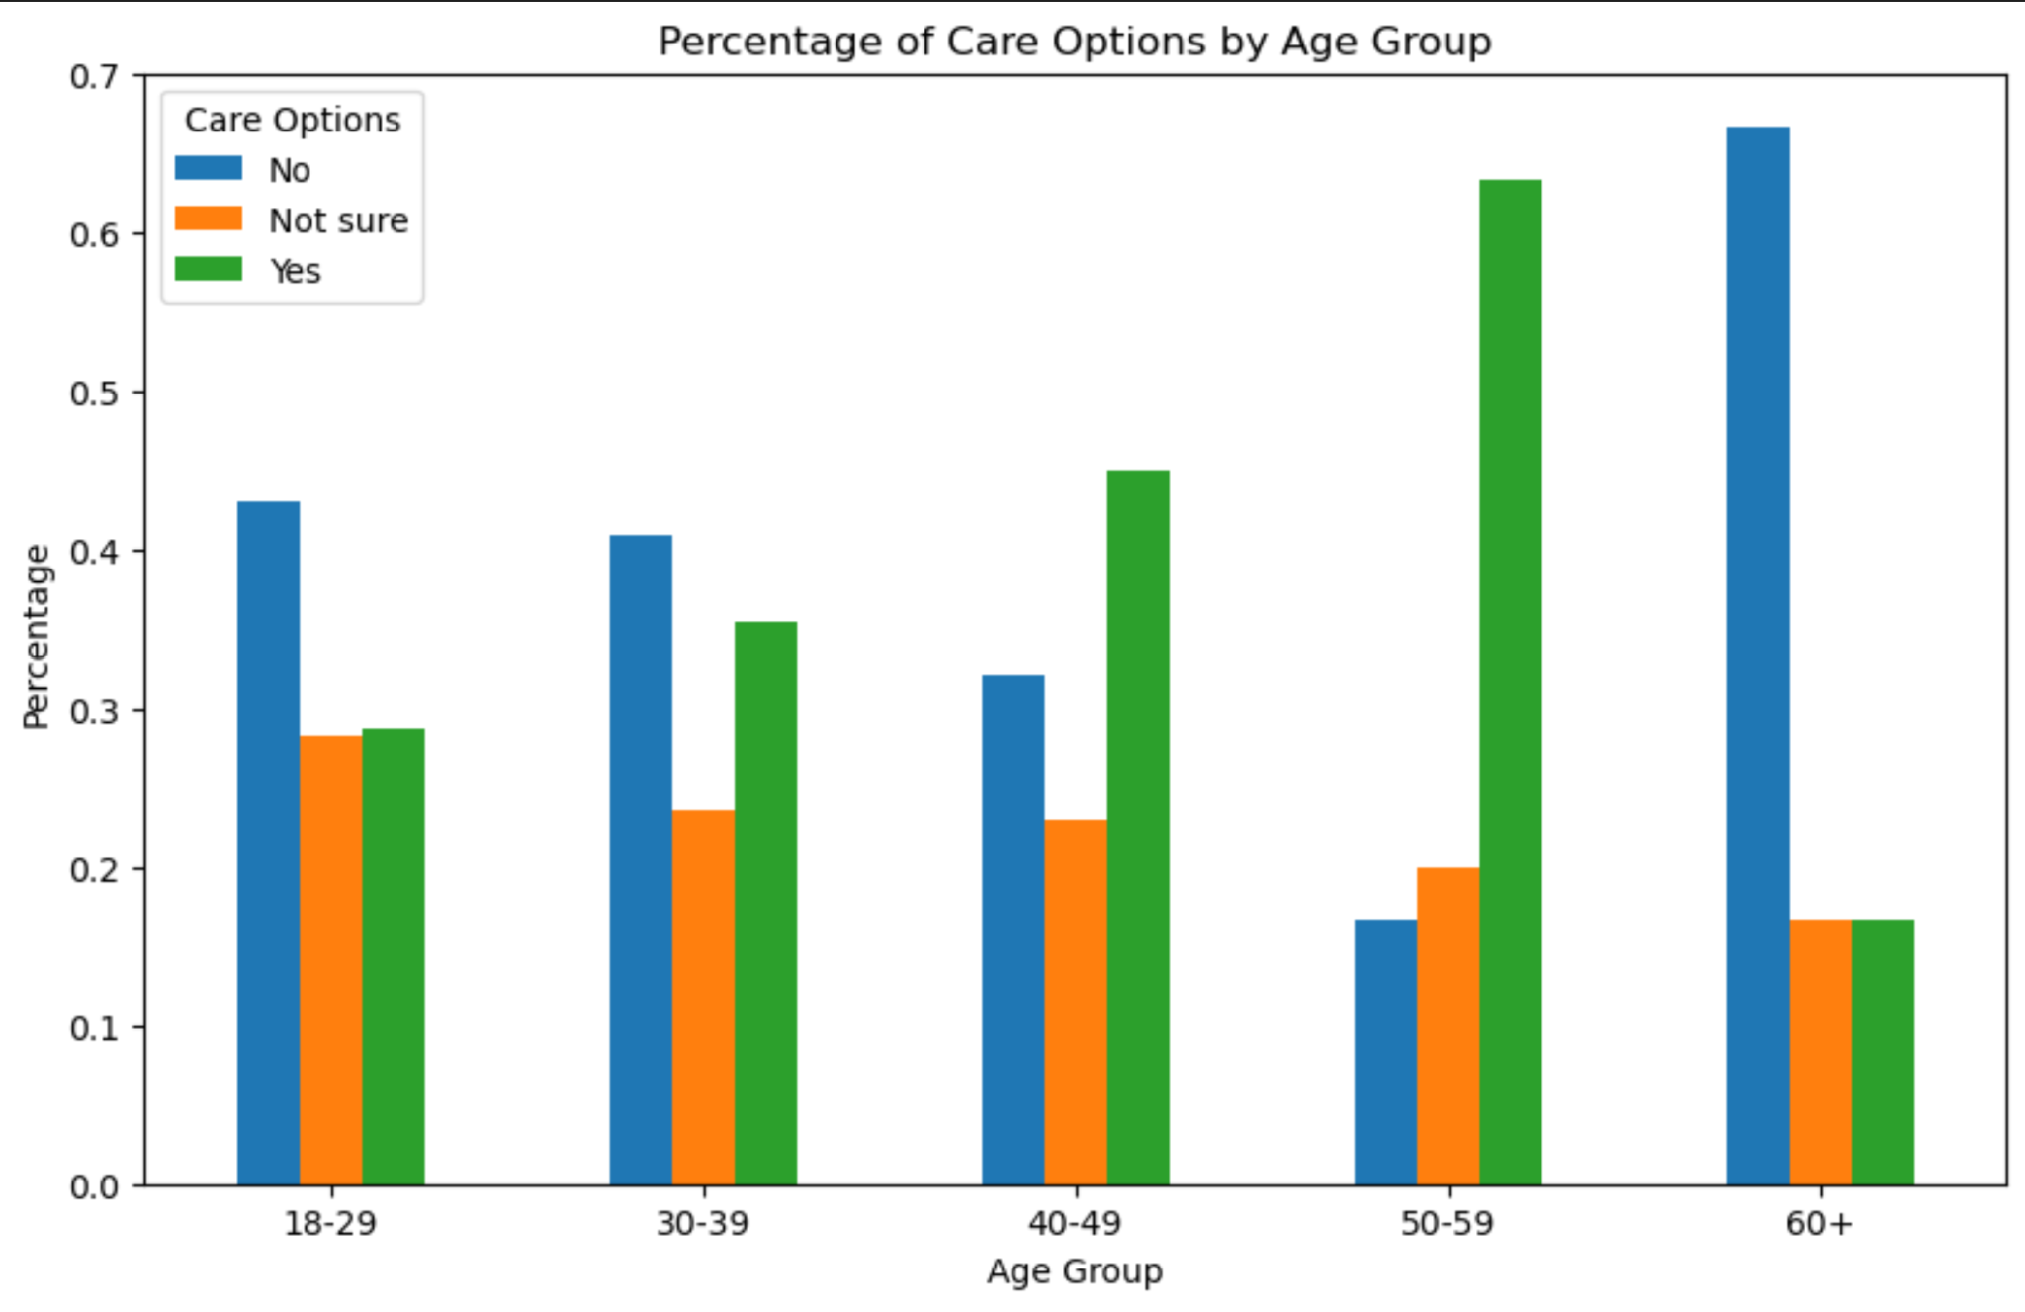
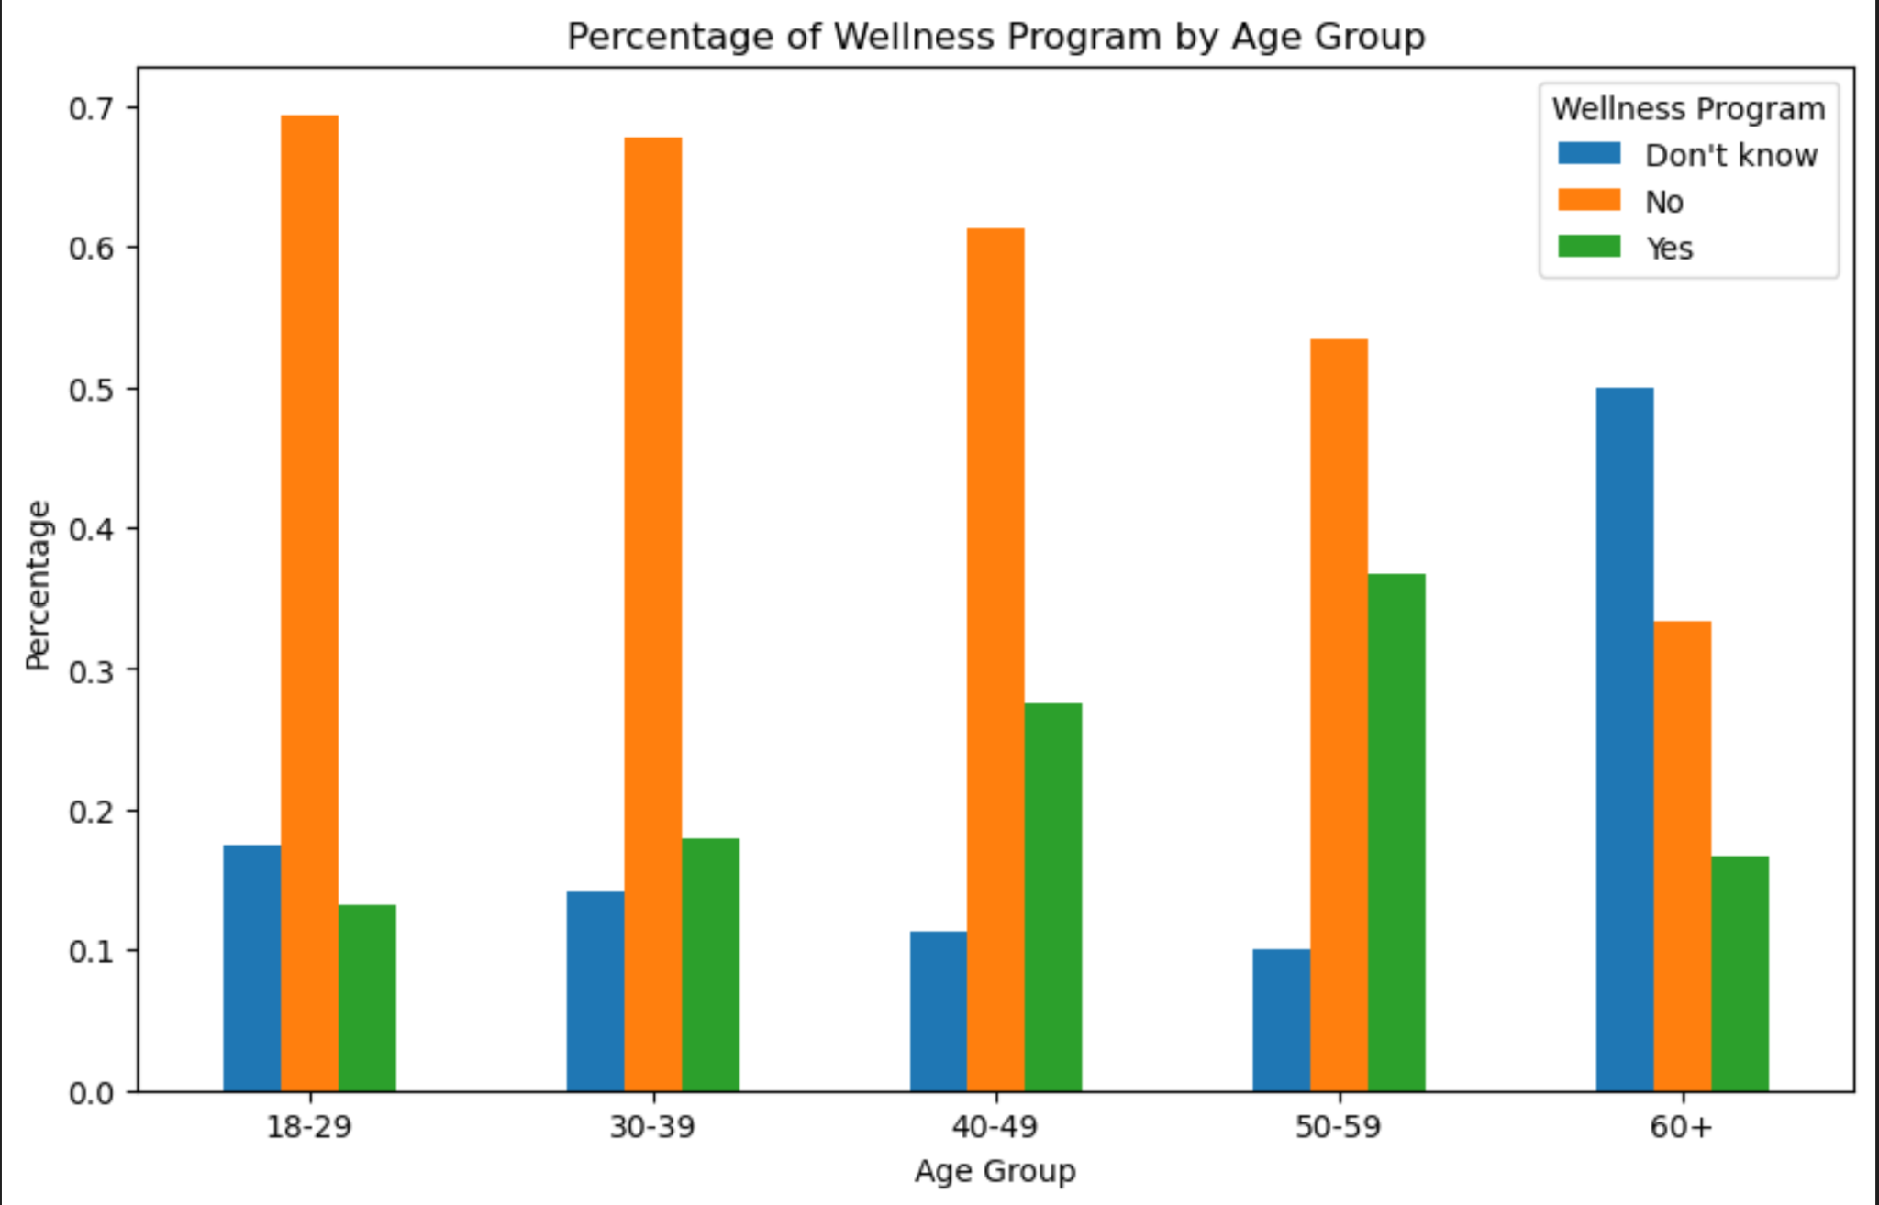
Data Visualizations

Slide 36
Question Two Summary and Hypothesis
Does remote work influence the access and/or awareness of mental health issues?
Availability or awareness of mental health benefits, care options, wellness programs
Are there differences in how often workers seek treatment?
Is there a difference in how often a worker may feel mental health can interfere with work?
Hypothesis: Non-remote workers would have a higher awareness of the benefits available to them and access them at a higher rate.

Slide 37
Analytical Findings
The main difference showcased in the data was a disparity between the availability of benefits
Non-remote workers answered “Yes” to having available mental health benefits at about a 10% higher rate than remote workers.
The other notable outcome was a very low level of wellness programs being offered across both

Slide 38
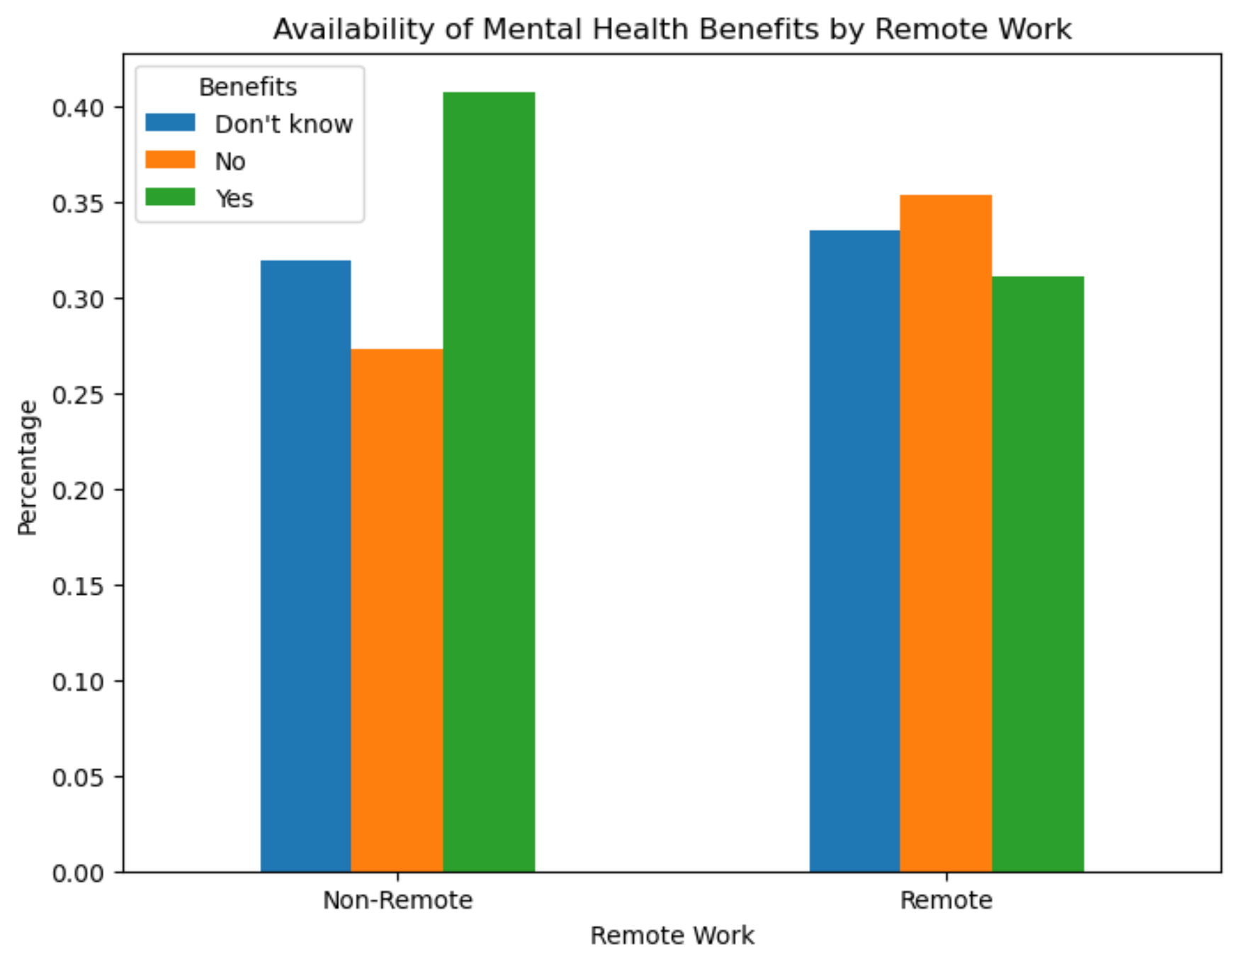
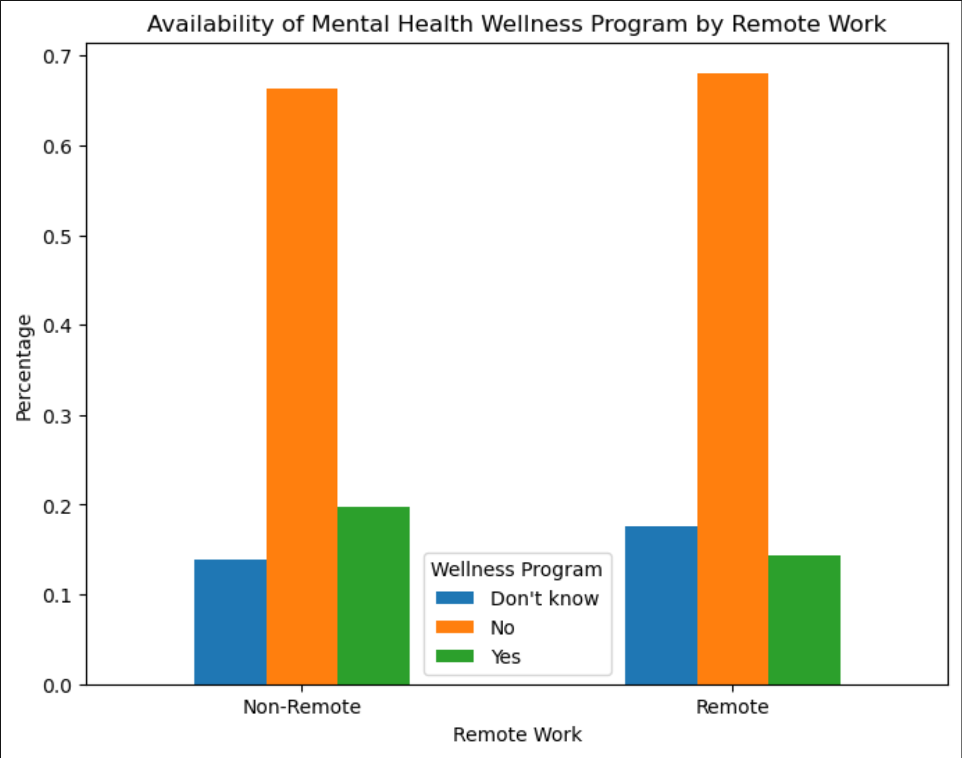
Data Visualizations

Slide 39

Thank you for listening!

